Slide 1
Processes and Threads
Chapter 4

Slide 2
CS 345
Stalling’s Chapter | # | Project
1: Computer System Overview 2: Operating System Overview | 4 | P1: Shell
3: Process Description and Control 4: Threads | 4 | P2: Tasking
5: Concurrency: ME and Synchronization 6: Concurrency: Deadlock and Starvation | 6 | P3: Jurassic Park
7: Memory Management 8: Virtual memory | 6 | P4: Virtual Memory
9: Uniprocessor Scheduling 10: Multiprocessor and Real-Time Scheduling | 6 | P5: Scheduling
11: I/O Management and Disk Scheduling 12: File Management | 8 | P6: FAT
Student Presentations | 6

Slide 3
Chapter 4 Learning Outcomes
Understand the distinction between process and thread.
Describe the basic design issues for threads.
Explain the difference between user-level threads and kernel-level threads.
Explain how threads are managed.
Describe the thread management facility in Windows 7.
Describe the thread management facility in Solaris.
Describe the thread management facility in Linux.

Slide 4
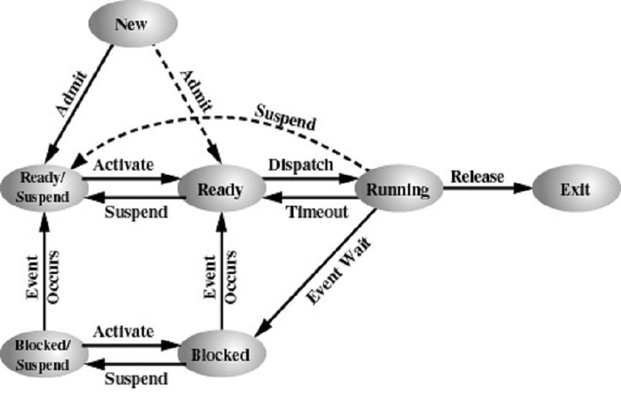
What is Moving/Changing?
Moving
Changing
✓
✓
✓
✓
✓
✓
✓
✓
✓
✓
✓
✓
✓
✓
Code
Context
Data
Files
Heap
Process
Processor
Stack
State
Tables
Thread
Unique ID

Slide 5
What is a Process?
Processes
Traditionally, a process is considered an instance of a computer program that is being executed.
A process contains
System resources: program code, user data, buffers, devices, I/O channels, files
Current activity: CPU, registers, state, execution path, “On the clock”, interleaved with other processes
Can resources and CPU activity be treated independently?
Unit of resource ownership → process or task
Unit of execution → thread or lightweight process

Slide 6
Processes (Heavy)
Processes
Resources owned by a process:
code ("text"),
data (VM),
stack,
heap,
files,
tables (signals, semaphores, buffers, I/O,…)
Context switching processes has a significant amount of overhead:
Tables have to be flushed from the processor when context switching.
Processes share information only through pipes and shared memory (IPC).

Slide 7
What is a Thread?
Threads
A thread of execution
Smallest unit of processing (context) that can be scheduled by an operating system
Threads reduce overhead by sharing the resources of a process.
Switching can happen more frequently and efficiently.
Sharing information is not so "difficult" anymore - everything can be shared.
A Thread is an independent program counter and stack operating within a process.
Sometimes called a lightweight process (LWP)
A smaller execution unit than a process.

Slide 8
Chapter 4 Learning Outcomes
Understand the distinction between process and thread.
Describe the basic design issues for threads.
Explain the difference between user-level threads and kernel-level threads.
Explain how threads are managed.
Describe the thread management facility in Windows 7.
Describe the thread management facility in Solaris.
Describe the thread management facility in Linux.

Slide 9
Threads and Processes
Threads
1:N User-level
Threading
(Java)
1:1 Kernel-level
Threading
(DOS)
one process
one thread
one process
multiple threads
multiple processes
one thread per process
multiple processes
multiple threads per process
Multi-tasking w/1:1
User-level threading
(UNIX)
M:N Hybrid Threading
(Windows, Solaris)

Slide 10
Multi-threading
Threads
Operating system or user may support multiple threads of execution within a single process.
Traditional approach is single process, single threaded.
Current support for mult-process, mult-threading.
Examples:
MS-DOS: single user process, single thread.
UNIX: multiple processes, one thread per process.
Java run-time environment: one process, multiple threads.
Windows 2000 (W2K), Solaris, Linux, Mach, and OS/2: multiple processes, each supports multiple threads.

Slide 11
Chapter 4 Learning Outcomes
Understand the distinction between process and thread.
Describe the basic design issues for threads.
Explain the difference between user-level threads and kernel-level threads.
Explain how threads are managed.
Describe the thread management facility in Windows 7.
Describe the thread management facility in Solaris.
Describe the thread management facility in Linux.

Slide 12
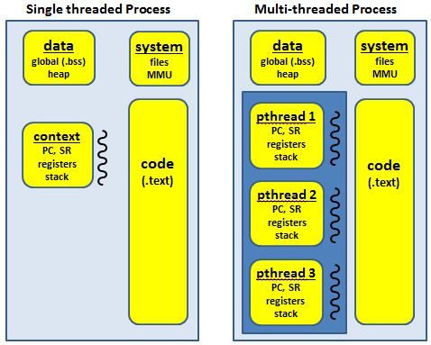
Multi-threading

Slide 13
What Types of Threads?
Threads
A thread consists of:
a thread execution state (Running, Ready, etc.)
a context (program counter, register set.)
an execution stack.
some per-tread static storage for local variables.
access to the memory and resources of its process (shared with all other threads in that process.)
OS resources (open files, signals, etc.)
Thus, all of the threads of a process share the state and resources of the parent process (memory space and code section.)
There are two types of threads:
User-space (ULT) and
Kernel-space (KLT).

Slide 14
User-Level Threads
ULT’s
User-level avoids the kernel and manages the tables itself.
Often this is called "cooperative multitasking" where the task defines a set of routines that get "switched to" by manipulating the stack pointer.
Typically each thread "gives-up" the CPU by calling an explicit switch, sending a signal or doing an operation that involves the switcher.
Also, a timer signal can force switches.
User threads typically can switch faster than kernel threads [however, Linux kernel threads' switching is actually pretty close in performance].

Slide 15
User-Level Threads
ULT’s
Disadvantages.
User-space threads have a problem that a single thread can monopolize the timeslice thus starving the other threads within the task.
Also, it has no way of taking advantage of SMPs (Symmetric MultiProcessor systems, e.g. dual-/quad-Pentiums).
Lastly, when a thread becomes I/O blocked, all other threads within the task lose the timeslice as well.
Solutions/work arounds.
Timeslice monopolization can be controlled with an external monitor that uses its own clock tick.
Some SMPs can support user-space multithreading by firing up tasks on specified CPUs then starting the threads from there [this form of SMP threading seems tenuous, at best].
Some libraries solve the I/O blocking problem with special wrappers over system calls, or the task can be written for nonblocking I/O.

Slide 16
Kernel-Level Threads
KLT’s
KLTs often are implemented in the kernel using several tables (each task gets a table of threads).
The kernel schedules each thread within the timeslice of each process.
There is a little more overhead with mode switching from user->kernel-> user and loading of larger contexts, but initial performance measures indicate a negligible increase in time.
Advantages.
Since the clocktick will determine the switching times, a task is less likely to hog the timeslice from the other threads within the task.
I/O blocking is not a problem.
If properly coded, the process automatically can take advantage of SMPs and will run incrementally faster with each added CPU.

Slide 17
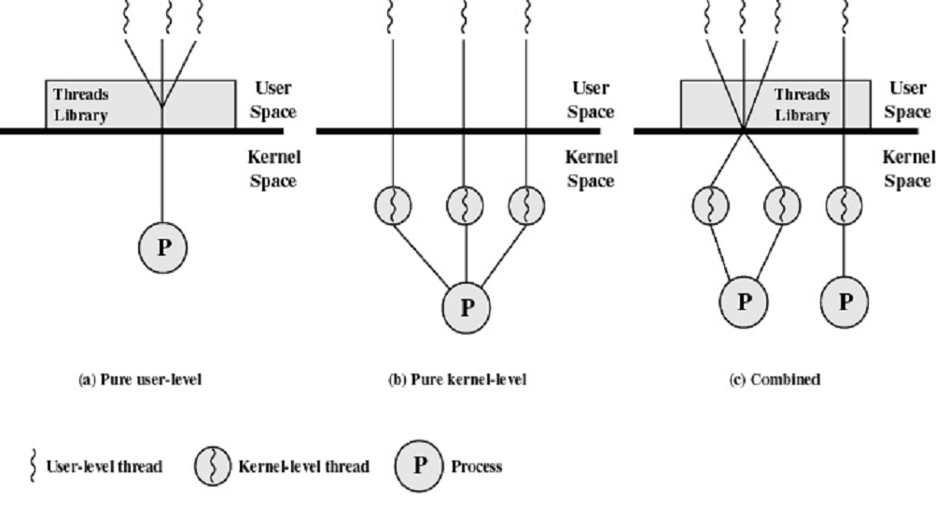
User-Level and Kernel-Level Threads
Thread Management

Slide 18
What are the Benefits of Threads?
Threads
A process has at least one thread of execution
May launch other threads which execute concurrently with the process.
Threads of a process share the instructions (code) and process context (data).
Key benefits:
Far less time to create/terminate.
Switching between threads is faster.
No memory management issues, etc.
Can enhance communication efficiency.
Simplify the structure of a program.

Slide 19
Using Threads
Threads
Multiple threads in a single process
Separate control blocks for the process and each thread
Can quickly switch between threads
Can communicate without invoking the kernel
Four Examples
Foreground/Background – spreadsheet updates
Asynchronous Processing – Backing up in background
Faster Execution – Read one set of data while processing another set
Organization – For a word processing program, may allow one thread for each file being edited

Slide 20
Multi-threaded Process
Threads

Slide 21
What are Possible Thread States?
Threads
Thread operations
Spawn – Creating a new thread
Block – Waiting for an event
Unblock – Event happened, start new
Finish – This thread is completed
Generally, it is desirable that a thread can block without blocking the remaining threads in the process
Allow the process to start two operations at once, each thread blocks on the appropriate event
Must handle synchronization between threads
System calls or local subroutines
Thread generally responsible for getting/releasing locks, etc.

Slide 22
Chapter 4 Learning Outcomes
Understand the distinction between process and thread.
Describe the basic design issues for threads.
Explain the difference between user-level threads and kernel-level threads.
Explain how threads are managed.
Describe the thread management facility in Windows 7.
Describe the thread management facility in Solaris.
Describe the thread management facility in Linux.

Slide 23
How do Threads Share Information?
Threads
Shared memory
Message passing
Communication Link
Send(message) /Receive (message)
Direct or indirect communication
Synchronous or asynchronous communication
Automatic or explicit buffering
Synchronization
Ports
Marshalling
RPC
Sockets
Pipes

Slide 24
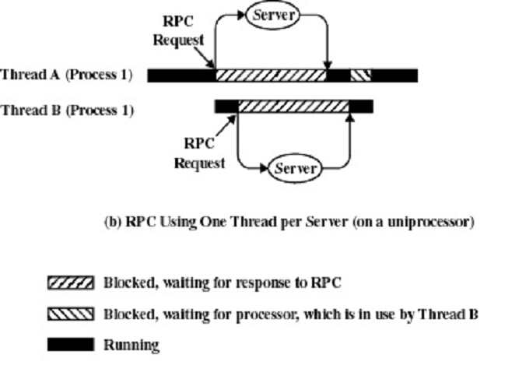
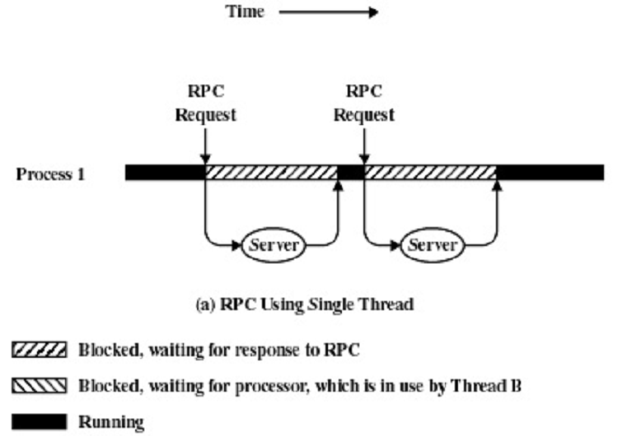
RPC
RPC’s
1. Client calls the client stub (stack).
2. Client stub packs (marshalls) parameters.
3. Client's OS sends message to server.
4. Server OS passes packets to server stub.
5. Server stub unpacks (unmarshalls) message.
6. Server stub calls the server procedure.
7. Reply traces in the reverse direction.
“A remote procedure call (RPC) is an inter-process communication that allows a computer program to cause a subroutine or procedure to execute in another address space (commonly on another computer on a shared network) without the programmer explicitly coding the details for this remote interaction.”

Slide 25
How are Threads Managed?
Thread Issues
How should threads be scheduled compared to processes?
Equal to processes
Within the parent processes quantum
How are threads implemented?
kernel support (system calls)
user level threads
What about mutual exclusion?
Process resources are shared
Data coherency

Slide 26
Thread Management
Thread Management
Some implementations support both ULT and KLT threads.
Can take advantage of each to the running task.
Since Linux's kernel-space threads nearly perform as well as user-space, the only advantage of using user-threads would be the cooperative multitasking.
OS system calls could each be written as a thread or OS could be single threaded.
Advantages: Speed and Concurrency
Disadvantages: Mutual exclusion and complexity

Slide 27
Thread Problems
In many other multithreaded OSs, threads are not processes merely parts of a parent task.
Therefore, if a thread calls fork()’s or execve()'s some external program, the whole task could be replaced.
The POSIX 1c standard defines a thread calling fork() to duplicate only the calling thread in the new process; and an execve() from a thread would stop all threads of that process.
Having two different implementations and schedulers for processes is a flaw that has perpetuated from implementation to implementation.
Some multitasking OSs have opted not to support threads due to these problems (not to mention the effort needed to make the kernel and libraries 100% reentrant).
For example, Windows NT opts not to support POSIX-compliant threads (Windows NT does support threads but they are not POSIX compliant).

Slide 28
Thread Problems
Most people have a hard enough time understanding tasks.
“Chopped up tasks" or threads is difficult to envision.
"What can be threaded in my app?".
Deciding what to thread can be very laborious.
Another problem is locking.
All the nightmares about sharing, locking, deadlock, race conditions, etc. come vividly alive in threads.
Processes don't usually have to deal with this, since most shared data is passed through pipes.
Threads can share file handles, pipes, variables, signals, etc.
Test and duplicate error conditions can cause more gray hair than a wayward child.

Slide 29
Thread Review
C Threads
How does a thread differ from a process?
Resource ownership
Smallest unit of processing that can be scheduled by an operating system
What are the implications of having an independent program counter?
Each thread has its own stack.
Code and global data belong to the process and are shared among threads.
Threads “own” local data.
Thread state is defined by processor registers and the stack.

Slide 30
Chapter 4 Learning Outcomes
Understand the distinction between process and thread.
Describe the basic design issues for threads.
Explain the difference between user-level threads and kernel-level threads.
Explain how threads are managed.
Describe the thread management facility in Windows 7.
Describe the thread management facility in Solaris.
Describe the thread management facility in Linux.

Slide 31
POSIX Thread Support
A thread library provides the programmer with API’s for creating and managing process threads.
Historically, hardware vendors have implemented their own proprietary versions of threads - differed substantially from each other making it difficult for programmers to develop portable threaded applications.
A standardized programming interface was required.
For UNIX systems, this interface has been specified by the IEEE POSIX 1003.1c standard (1995). Implementations which adhere to this standard are referred to as POSIX threads, or Pthreads.
Most hardware vendors now offer Pthreads in addition to their proprietary API's

Slide 32
POSIX Thread Support
The three main thread libraries in use today are POSIX Pthreads, Windows, and Java.
For POSIX Pthreads, any data declared globally (outside of any function) is shared among all threads belonging to the same process.
Each POSIX thread has its own execution context, that is, a program counter (PC), status register (SR), a register set (r4-415), and a stack (SP). Thus local variables are not shared among process threads.
Pthreads are defined as a set of C language programming types and procedure calls.
Vendors usually provide a Pthreads implementation in the form of a header/include file and a library, which you link with your program.

Slide 33
POSIX Thread Support
Threaded applications offer potential performance gains:
Overlapping CPU work with I/O - a program may have sections performing long I/O operation while other threads can perform CPU intensive work.
Priority/real-time scheduling: tasks, which are more important, can be scheduled to supersede or interrupt lower priority tasks.
Asynchronous event handling: tasks, which service events of indeterminate frequency and duration, can be interleaved. For example, a web server can both transfer data from previous requests and manage the arrival of new requests.
Multi-threaded applications that work on a uniprocessor system take advantage of a multiprocessor system, without recompiling.
In a single processor environment, threads still offer better CPU utilization during I/O, program modularization, and better user response times.

Slide 34
Windows Thread Support
Windows NT opted not to support POSIX-compliant threads (Windows NT does support threads but they are not POSIX compliant).
A process is an executing program
A thread is the basic unit allocated processor time.
A job object is a managable group of processes.
A thread pool is a collection of worker threads.
A fiber is unit of execution manually scheduled by application.
Better programming model that POSIX threads.
Simplicity of data types (Windows uses HANDLE).
WaitForMultipleObjects functionality.
Persistence of signals. (POSIX signals are lost if there is no conditional expression.)

Slide 35
Linux Thread Support
Linux threads are a partial implementation of POSIX Threads.
Superseded by the Native POSIX Thread Library (NPTL).
Linux Threads has problems, mainly owing to the implementation, which used the clone system call to create a new process sharing the parent's address space.
Distinct process identifiers cause problems for signal handling; signals SIGUSR1 and SIGUSR2 usurped for inter-thread coordination and can not be used by programs.
Linux 1.3.56 introduced support for KLT’s.
On-going effort to refine and make the kernel more reentrant.
With the introduction of 2.1.x, the memory space is being revised so that the kernel can access the user memory more quickly.

Slide 36
Solaris Threads
Solaris threads and POSIX pthreads API’s do not match exactly, although the information content is effectively the same.
Solaris Threads (libthread) | pthreads (libpthread)
thr_create() thr_exit() thr_join() thr_yield() thr_self() thr_kill() thr_sigsetmask() thr_setprio() thr_getprio() thr_setconcurrency() thr_getconcurrency() thr_suspend() thr_continue() | pthread_create() pthread_exit() pthread_join() sched_yield() POSIX.4 pthread_self() pthread_kill() pthread_sigmask() pthread_setschedparam() pthread_getschedparam() pthread_setconcurrency() pthread_getconcurrency() - -

Slide 37
Questions to answer…
What is a Process?
What is a Thread?
What are the different types of Threads?
What are the benefits of Threads?
What are possible Thread States?
How do Threads Share Information?
How are Threads managed?
How are ULT’s created in C?

Slide 38
